Slide 1
Visual Designs – Task 1b
CityPoint Room Hire – Wireframes, Sitemaps, and Annotations

Slide 2
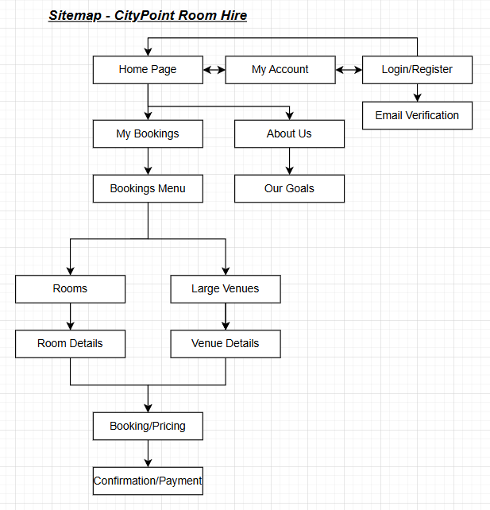
For my Sitemap I decided to go for a simple design that allows for users to be able to access all pages from the homepage.

